Slide 1
Bird population trends and rarity
Zenon Nowakowski

Slide 2
What we are working with
Utilized: “NCRN Bird Monitoring Data 2007 - 2017” dataset
Dimensions: 29 columns, 14230 entries
Size: 2.8 mb

Slide 3
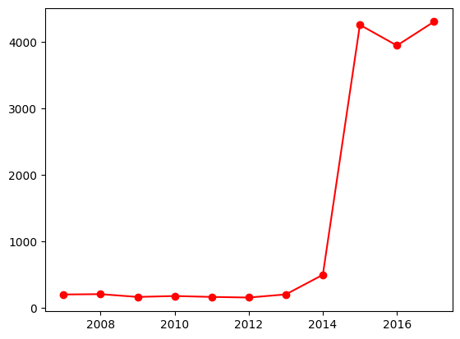
Common Bird data
Overall bird sightings where at a very large increase from 2014 onward. Though this is due to a variety of factors. Regardless other analysis has shown many bird populations to be in an overall positive direction.

Slide 4
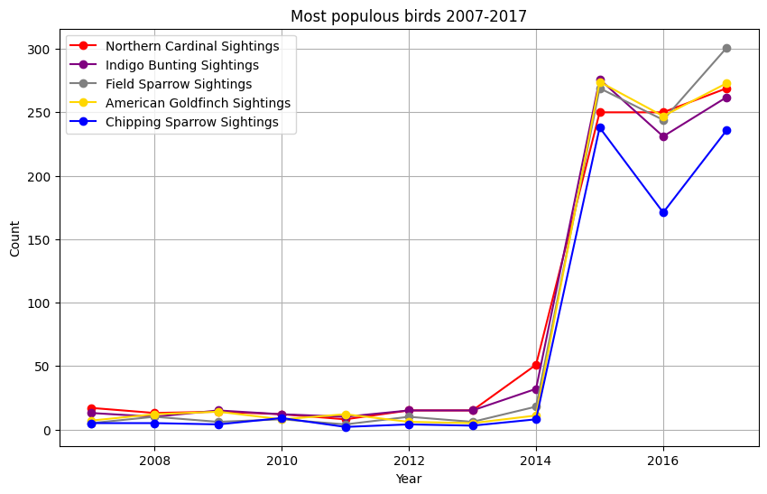
Common Bird data
Overall bird sightings where at a very large increase from 2014 onward. Though this is due to a variety of factors. Regardless other analysis has shown many bird populations to be in an overall positive direction.

Slide 5
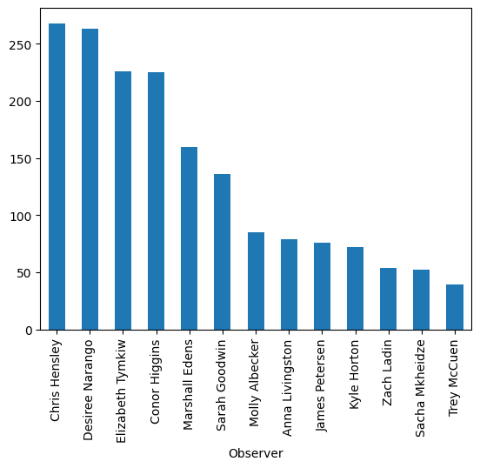
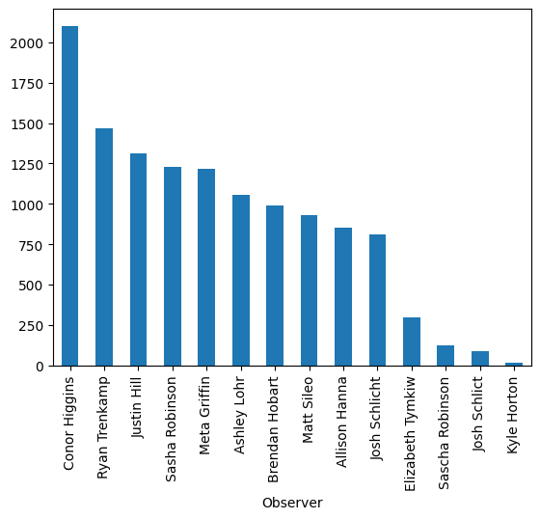
Data on observers
Data showing observers, on the left is observers from 2007-2014. On the right is observers from 2015-2017.

Slide 6
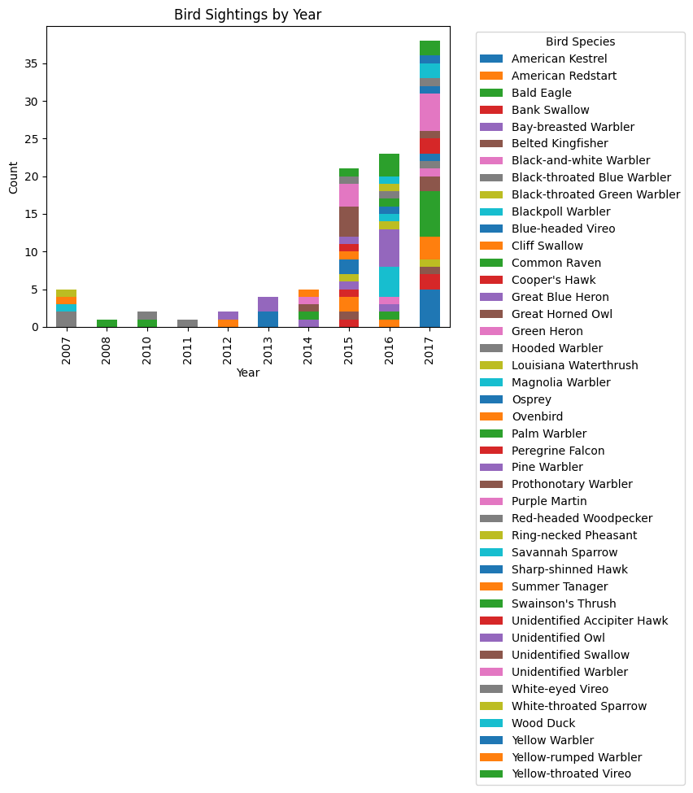
Rare bird sightings
While most of these birds are not endangered they are rare to spot in the given areas this survey took place.This graph depicts the years they where spotted.

Slide 7
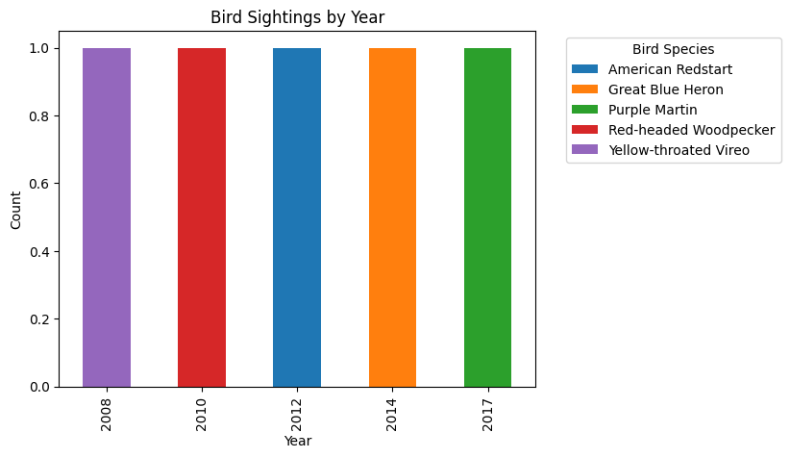
The Rarest club

